Slide 1


City quest

Slide 2

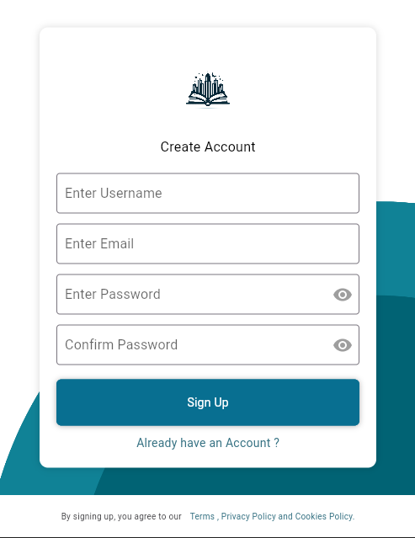
Register view
"Within our city guide's interface, the registration view is designed to offer a delightful user experience. Users are greeted with a clean and inviting layout, guiding them through the registration process effortlessly. By simply filling out a few fields, users unlock a world of personalized content and exclusive features. The registration view exemplifies simplicity and convenience, ensuring that users can quickly join our community and embark on their journey to explore our vibrant city."

Slide 3

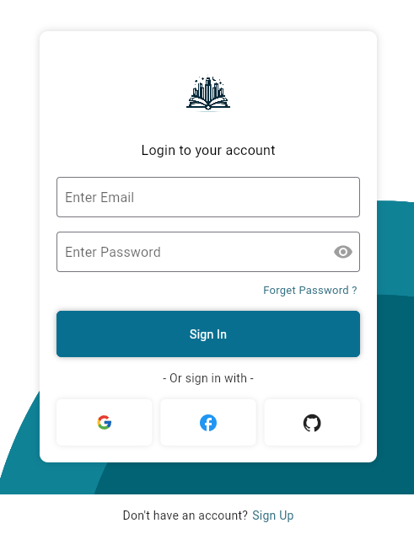
login view
"Before accessing our city guide's extensive features, users will encounter a streamlined login process. The login page, adorned with an intuitive design, prompts users to first register. Upon registration, users gain access to personalized features and tailored recommendations. Once registered, logging in becomes a seamless experience, providing instant access to a wealth of information about our city's attractions, dining hotspots, and cultural events."

Slide 4
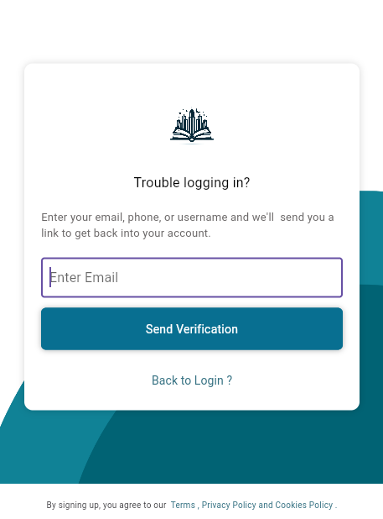

Forget password
"Lost your password? No worries! Our city guide's 'Forget Password' feature has got you covered.
With just a few clicks, users can easily reset their password and regain access to their account.
Our intuitive interface guides users through a seamless process, ensuring hassle-free password recovery. Say goodbye to login woes and hello to uninterrupted exploration of our city's treasures."

Slide 5

Navbar
"Embark on a seamless journey through our city's wonders with our dynamic navbar. Explore 'Cities' to discover diverse destinations, from bustling urban hubs to serene countryside retreats.
Delight your taste buds with 'Food' as we curate culinary delights from local eateries to fine dining establishments. Uncover hidden 'Places' brimming with history, culture, and natural beauty. Navigate effortlessly with 'Map' as we guide you through our city's streets and landmarks. Experience the charm of our city with just a click, powered by our beloved APIs

Slide 6

Home view
"Welcome to our vibrant home page, your portal to endless discovery. Dive in with a sleek 'Search Bar' and captivating 'Carousel', offering quick access to our city's wonders.
Explore curated 'Categories' and personalized 'Recommendations', guiding your journey with precision and flair. Engage with interactive 'Cards', each unveiling a new adventure at your fingertips.
Experience the pulse of our city in a single glance, where every click ignites a new chapter of exploration, fueled by our passion for discovery."

Slide 7
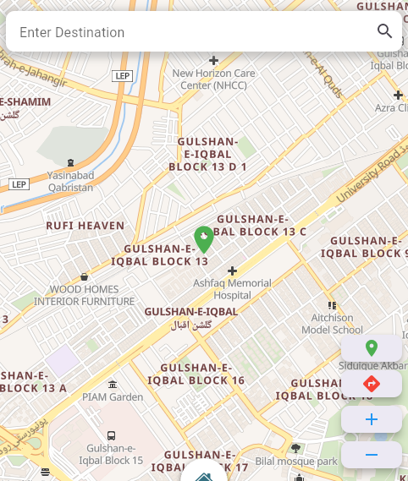



Map view: Explore Your World
Interactive Map:
Search Bar:
Navigate seamlessly through our city's landscape with our interactive map feature.
Zoom control:
Get up close and personal or zoom out for a broader view of our city's attractions using our intuitive zoom controls.
Discover specific locations effortlessly with our search bar feature, allowing you to pinpoint destinations with ease.
Live Updates:
Stay informed with live updates and real-time data, ensuring you never miss out on the latest happenings and events in our vibrant city

Slide 8


Comparison 02
Search Functionality
Real-Time Data: Leveraging Web APIs allows us to access real-time data feeds, ensuring that the information displayed on our map view is always up-to-date.
Dynamic Functionality: Web APIs enable dynamic functionality within our map view, allowing for features such as live updates, interactive overlays, and responsive search capabilities.
Customization and Flexibility: With Web APIs, our map view offers customization and flexibility, allowing us to tailor the user experience to meet your specific needs and preferences.
Location-Based Search: Our search functionality allows you to search for specific locations within our city by entering keywords, addresses, or landmarks.
Autocomplete Suggestions: As you type your search query, our system provides autocomplete suggestions, helping you find what you're looking for faster.
Geolocation Integration: For users accessing our platform on mobile devices, our search functionality seamlessly integrates with geolocation services, providing personalized search results based on your current location.
Integration with Web APIs

Slide 9


team
Hassan Durra
ramesha
AMNA
SANIYA

Slide 10

Thank you

